Slide 1

v
DevOps
Suresh
July 19, 2022

Slide 2
Contents
Secure Development Lifecycle (SDL)
Popular SDL methodologies & Benefits
SSDL stages
Software Security best practices
Information Security
InfoSec Types, Risks and Technologies
InfoSec Management Practices

Slide 3
SDLC
A software development life cycle (SDLC) is a framework for the process of building an application from inception to decommission. Over the years, multiple SDLC models have emerged—from waterfall and iterative to, more recently, agile and CI/CD, which increase the speed and frequency of deployment.

Slide 4
Secure Development Lifecycle
There is a ready-made solution that provides a structured approach to application security—the secure development lifecycle (SDL). It is a set of development practices for strengthening security and compliance. For maximum benefit, these practices should be integrated into all stages of software development and maintenance.

Slide 5
Three Popular Methodologies:
Microsoft Security Development Lifecycle (SDL)
OWASP Software Assurance Maturity Model (SAMM)
Building Security In Maturity Model (BSIMM)

Slide 6
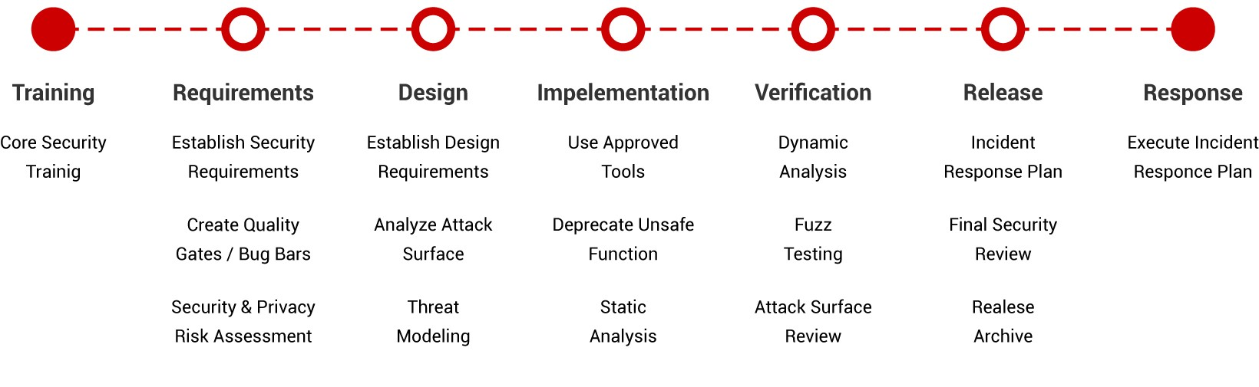
Microsoft Security Development Lifecycle (SDL)

Slide 7
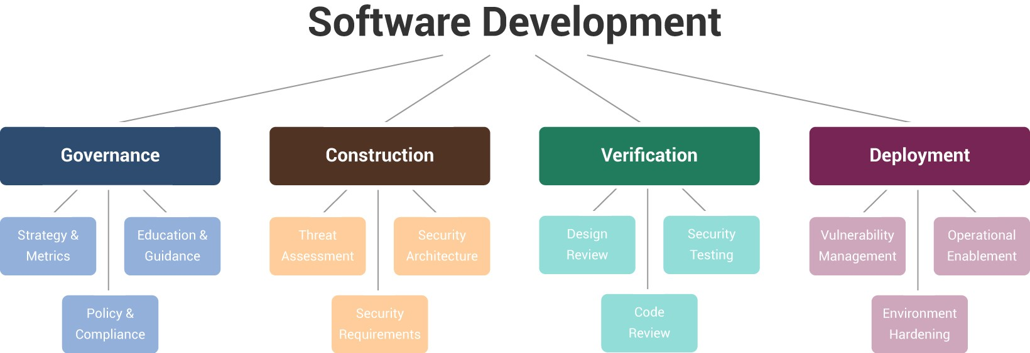
OWASP Software Assurance Maturity Model (SAMM)

Slide 8
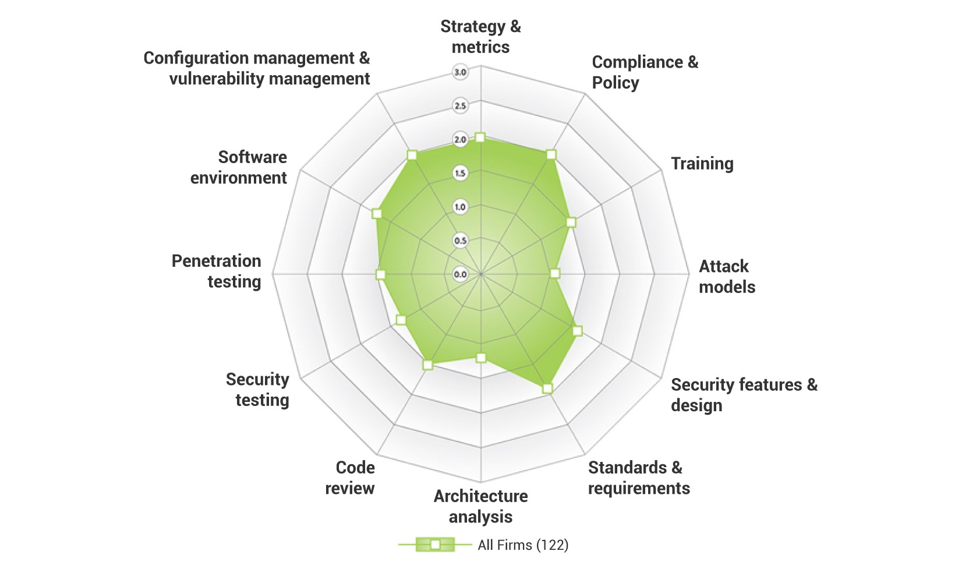
Building Security In Maturity Model (BSIMM)

Slide 9
Benefits of SDL
Higher Security
Cost Reduction
Regulatory Compliance

Slide 10
SSDL organize into 4 stages
Prepare the Organization (PO): Ensure that an organization’s people, processes, and technology are prepared to perform secure software development at the organization level and, in some cases, for each individual project.
Protect the software (PS): Protect all components of the software from tampering and unauthorized access.
Produce Well-secured Software (PW): Software that has minimal vulnerabilities in its releases
Respond to Vulnerabilities (RV): Identify vulnerabilities in software releases and respond appropriately to address these vulnerabilities and prevent similar vulnerabilities from occurring in the future.
All these stages are again followed by 4 elements
Practice, Task and Example

Slide 11
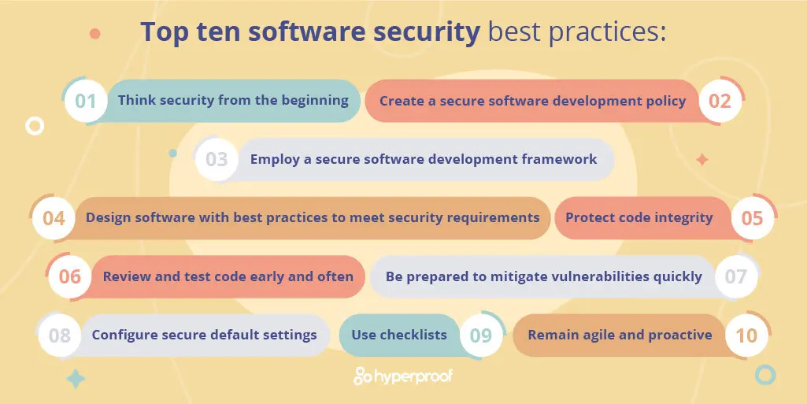

Slide 12
Information security (InfoSec)
Information security (InfoSec) enables organizations to protect digital and analog information. InfoSec provides coverage for cryptography, mobile computing, social media, as well as infrastructure and networks containing private, financial, and corporate information. Cybersecurity, on the other hand, protects both raw and meaningful data, but only from internet-based threats.

Slide 13
Information Security vs Cybersecurity
Information security is a broader category of protections, covering cryptography, mobile computing, and social media. It is related to information assurance, used to protect information from non-person-based threats, such as server failures or natural disasters.
Cybersecurity only covers Internet-based threats and digital data. Additionally, cybersecurity provides coverage for raw, unclassified data while information security does not.

Slide 14
Types of information security
Application security
Infrastructure security
Cloud security
Cryptography
Incident response
Vulnerability management
Disaster recovery

Slide 15
Common information security risks
Social engineering attacks
Advanced persistent threats (APT)
Insider threats
Cryptojacking
Distributed denial of service (DDoS)
Ransomware
Man-in-the-middle (MitM) attacks

Slide 16
Information security technologies
Firewalls
Security incident and event management (SIEM)
Data loss prevention (DLP)
Intrusion detection system (IPS)
User behavioral analytics (UBA)
Blockchain cybersecurity
Endpoint detection and response (EDR)
Cloud security posture management (CSPM)

Slide 17
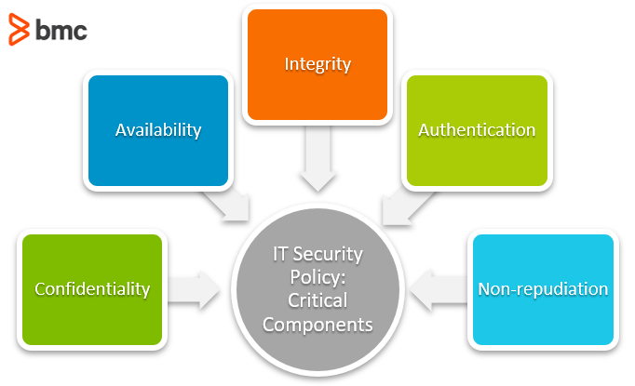
Information Security Management practices

Slide 18
Github best practices
1. Never store credentials as code/config in GitHub
2. Remove Sensitive data in your files and GitHub history
3. Tightly Control Access
4. Add a SECURITY.md file
5. Validate your GitHub Applications Carefully
7. Use the Right GitHub Offering for your Security Needs
8. Rotate SSH keys and Personal Access Tokens
9. Create New Projects with Security in Mind
10. Audit any Code you Import into GitHub

